Slide 1
GENFORGE - TOOLS FOR MODERNIZING THE WORKSPACE
Presented By Group F
GROUP MEMBERS:
SUPERVISOR
Harsh Singh (L)
Aman Singh
Sejal Pandey
Samiksha Mishra
Shreya Yadav
Er. Alka Singh

Slide 2

TABLE OF CONTENT
1. Introduction
2. Reason For Choosing This Project.
3. Technology Use
4. What Our Web Page Is About
5. How It Is Working
6. Future Work
7. Reference
01

Slide 3

INTRODUCTION
Welcome to GenForege, an amazing AI project that makes life simpler and more exciting. We use cutting-edge technologies like OpenAI, TypeScript, and more to create smart tools for everyday tasks.
One of our tools helps you decorate and set up rooms effortlessly. But that's just the beginning! We're working on more tools to solve different challenges.
GenForge is always evolving to stay ahead in the world of AI. We promise intelligent and user-friendly solutions. We're committed to making your life easier and more magical with our future tools. Get ready for a bright future with GenForge!
02

Slide 4
REASON FOR CHOOSING THIS PROJECT
GenForge helps make life easier by using smart technology. It's like having a friend that gives great ideas for decorating your rooms. You just show it pictures, and it suggests cool ways to make your living spaces better.
People like GenForge because it's not complicated – it's like having a helpful buddy using fancy technology to make things simple. The demand for GenForge comes from folks who want easy solutions for their daily tasks.
As technology keeps growing, GenForge plans to bring even more tools to make life smoother. It's like a friend that keeps getting smarter and more helpful. So, as we move forward, GenForge aims to be the go-to choice for making life smart and easy.
03

Slide 5









TECHNOLOGY USE
React.js
Tailwind CSS
Flask
Bun
Open AI
ASP.NET Core
Tensorflow
Scala
Matlab
04

Slide 6
WHAT OUR WEB PAGE IS ABOUT
Our website is all about GenForge – a fantastic project that brings the power of artificial intelligence (AI) into your hands.
One of our tools, currently in action, focuses on room setup and decoration. By analyzing pictures of rooms, it suggests creative ways to enhance your living spaces. This is just the beginning – we have more tools in progress, each addressing unique tasks and scenarios.
GenForge is always growing, and we're staying updated with the latest in smart tech, We've got more tools coming to add a bit of sparkle to your everyday experiences!
05

Slide 7
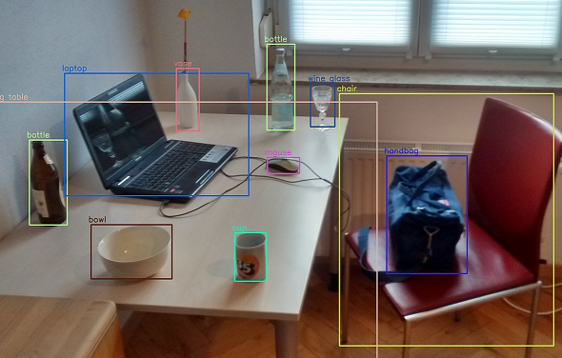
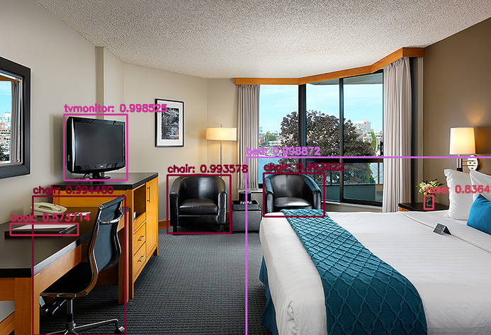
HOW IT IS WORKING
The backend of GenForge's room decoration project processes images in a sophisticated manner. Here's a simplified breakdown of the internal workings:
Image Analysis: When you upload a picture of your room, the backend utilizes advanced algorithms, possibly powered by technologies like OpenAI, to analyze the image. It identifies key elements such as furniture, colours, lighting, and overall layout.
06

Slide 8
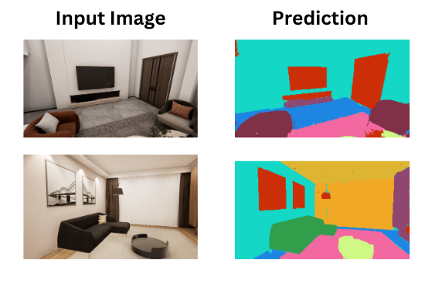
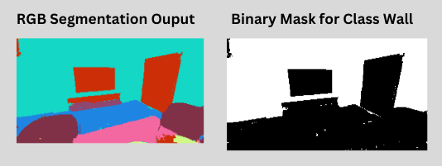
Data Interpretation: The system interprets the data gathered from the image, understanding the existing design and aesthetics of the room. It might recognize patterns, styles, and elements that define the room's visual appeal.
Algorithmic Creativity: Using a clever model, the backend employs algorithms to generate creative and personalized design suggestions. For bedrooms, it focuses on modern and professional styles. This involves recommending changes in furniture placement, color schemes, or additional decorative elements.
07

Slide 9
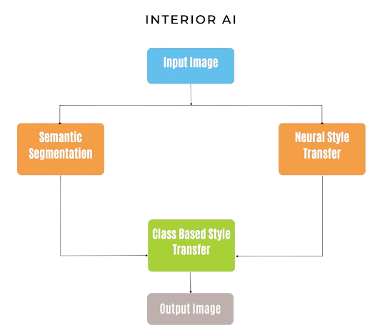
Output Generation: The final output is a set of suggestions to enhance the room's aesthetics. This could include recommendations for rearranging furniture, choosing complementary colours, or adding specific decor items. The output aims to provide practical and visually appealing ideas based on the AI's analysis.
08

Slide 10
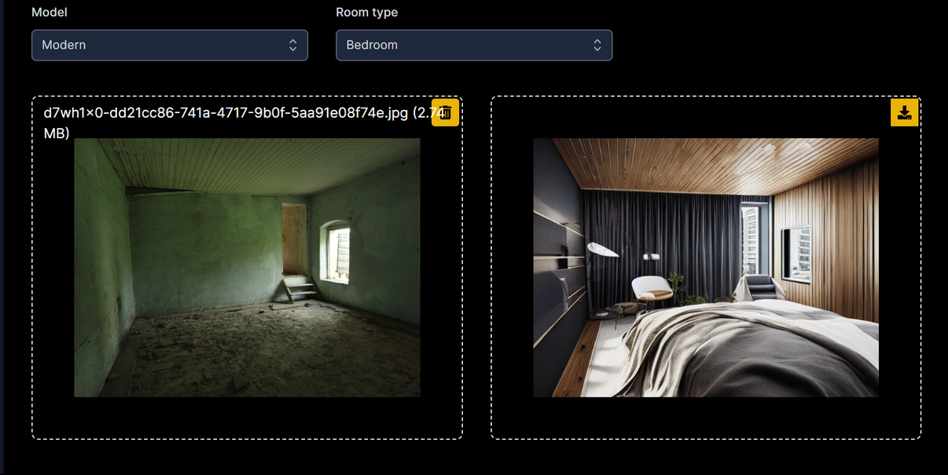
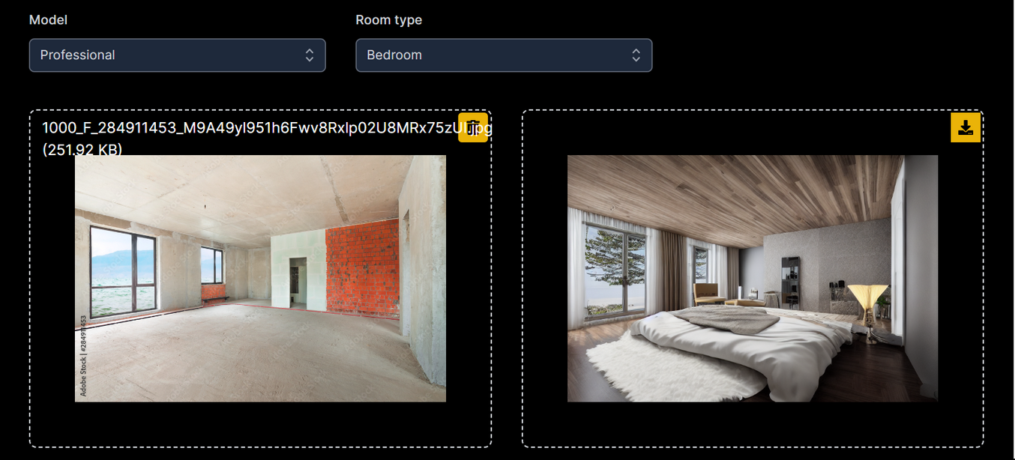
MODERN
PROFESSIONAL
10

Slide 11
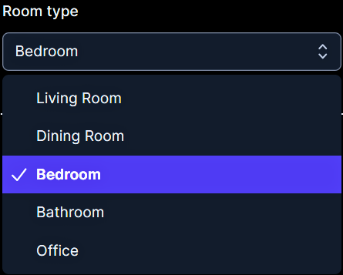
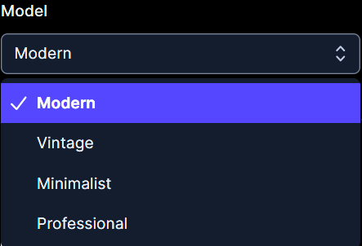
FUTURE WORK
Right now, GenForge helps you design bedrooms in a modern and professional way. But, in the future, we're planning to add more cool features. You'll be able to design living spaces, bathrooms, offices, and dining rooms in vintage and minimalist styles. We want to give you more options to make every part of your home uniquely yours. Stay tuned for these exciting updates as GenForge grows.
11

Slide 12
REFERENCE
https://docs.opencv.org/4.x/
https://stackoverflow.com/
https://developer.mozilla.org/en-US/
https://docs.scala-lang.org/
https://ai.wharton.upenn.edu/
https://www.th-deg.de/ain-b-en
https://www.lfd.uci.edu/~gohlke/pythonlibs/
https://docs.blender.org/api/current/
12

Slide 13

Thank You!
reallygreatsite.com

